Slide 1
Perspectives: An Open Invitation to Cultural Anthropology, 2e
Religion

Slide 2
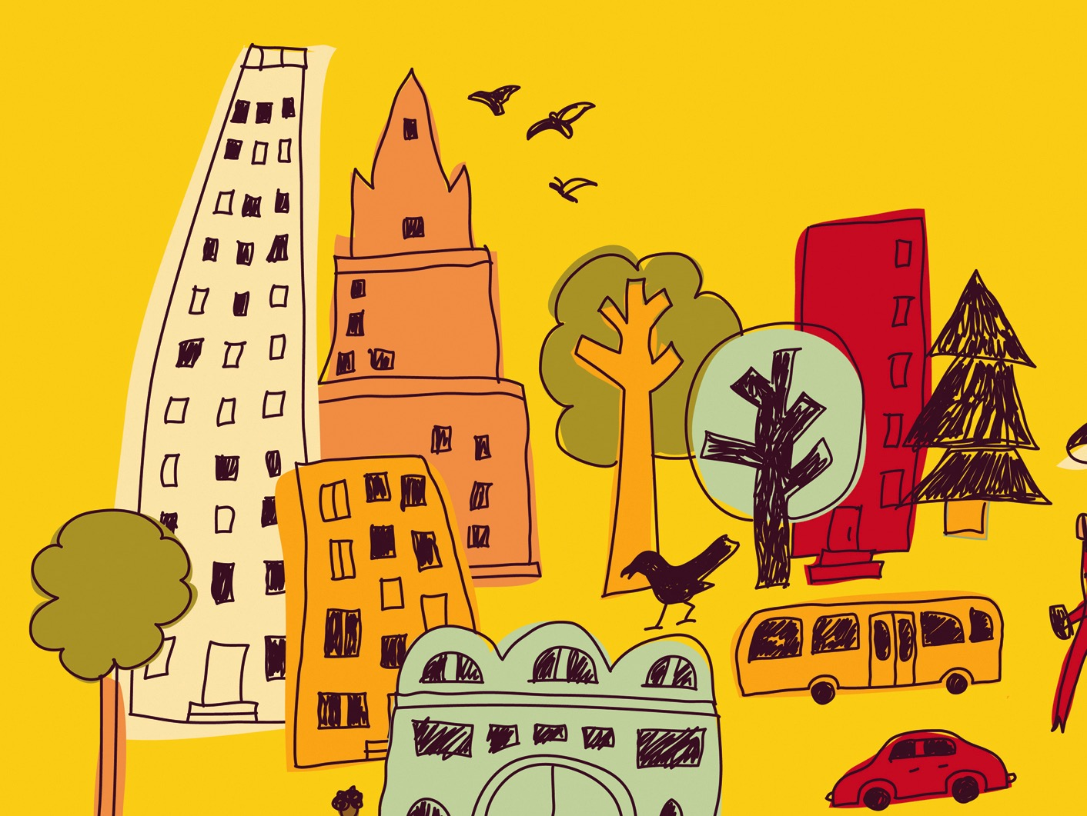
Learning Objectives
The significance of religion
The importance of supernatural beliefs in human communities
Four elements of religion
Rites

Slide 3
Early Signs of Religious Thought
Burials with stone tools, shells, animal bones
Cave paintings with animals and abstract images
Venus figurine sculptures

Slide 4
Defining Religion
Difficult to define because so many forms exist
Many societies do not make a distinction between “religious” and daily cultural practices
Some societies see spiritual beings and forces as inhabiting our physical world
A broad definition of religion is “the means by which human society and culture is extended to include the nonhuman”

Slide 5
Theories of Religion
Functional approach (Malinowski) – religion is born out of the problems of human life
Social approach (Durkheim) – difference between sacred and profane objects
Power (Marx) – religion helps justify inequalities in power and status

Slide 6
Theories of Religion
Psychological (Freud) – keeps us from acting on our worst instincts
Economic (Harris) – beliefs develop to aid in peoples’ survival in their environment
Symbolic (Geertz) – symbols represent cultural ideals and reinforce values

Slide 7
Elements of Religion
Cosmology – an explanation for the origin or history of the world
Ancient Greeks; Navajo; Book of Genesis
Belief in the supernatural – a realm beyond direct human experience

Slide 8
Elements of Religion
Rules governing behavior – proper conduct, what is right and wrong
Ritual – practices or ceremonies that serve a religious purpose

Slide 9
Belief in the Supernatural
Animatism – belief in an impersonal supernatural force (Ex: mana)
Animism – belief in supernatural beings, spirits, or aspects of humans (the soul)
Spirits generally make demands on the living
Ex: Filial piety in China; Japanese Shintoism
Gods – powerful non-human spirits
Monotheistic (single deity) or Polytheistic (multiple deities)

Slide 10
Rules of Behavior
Important element of social control, define misbehaviors and (supernatural) punishments
Ex: Buddhism uses the idea of karma to guide behavior with the goal of reincarnation

Slide 11
Rituals and Religious Practitioners
Rites of Passage – a ceremony designed to transition individuals between life stages
Separation, liminality, reincorporation
Rites of Intensification – actions designed to bring a community together (communitas)
Revitalization rituals – solving serious problems through supernatural intervention (Ex: John Frum “cargo cult”)

Slide 12
Rituals and Religious Practitioners
Priest – full-time religious practitioners
May be of any gender, have authority to set rules and control access to religious rites
Shaman – part-time religious practitioner
Often a calling for those who have personality traits that seem “abnormal” in the context of the community
Prophet – person who claims to have direct communication with the supernatural realm
Ex: David Koresh, Branch Davidians (millenarians)

