Slide 1
Perspectives: An Open Invitation to Cultural Anthropology, 2e
Culture and Sustainability: Environmental Anthropology in the Anthropocene

Slide 2
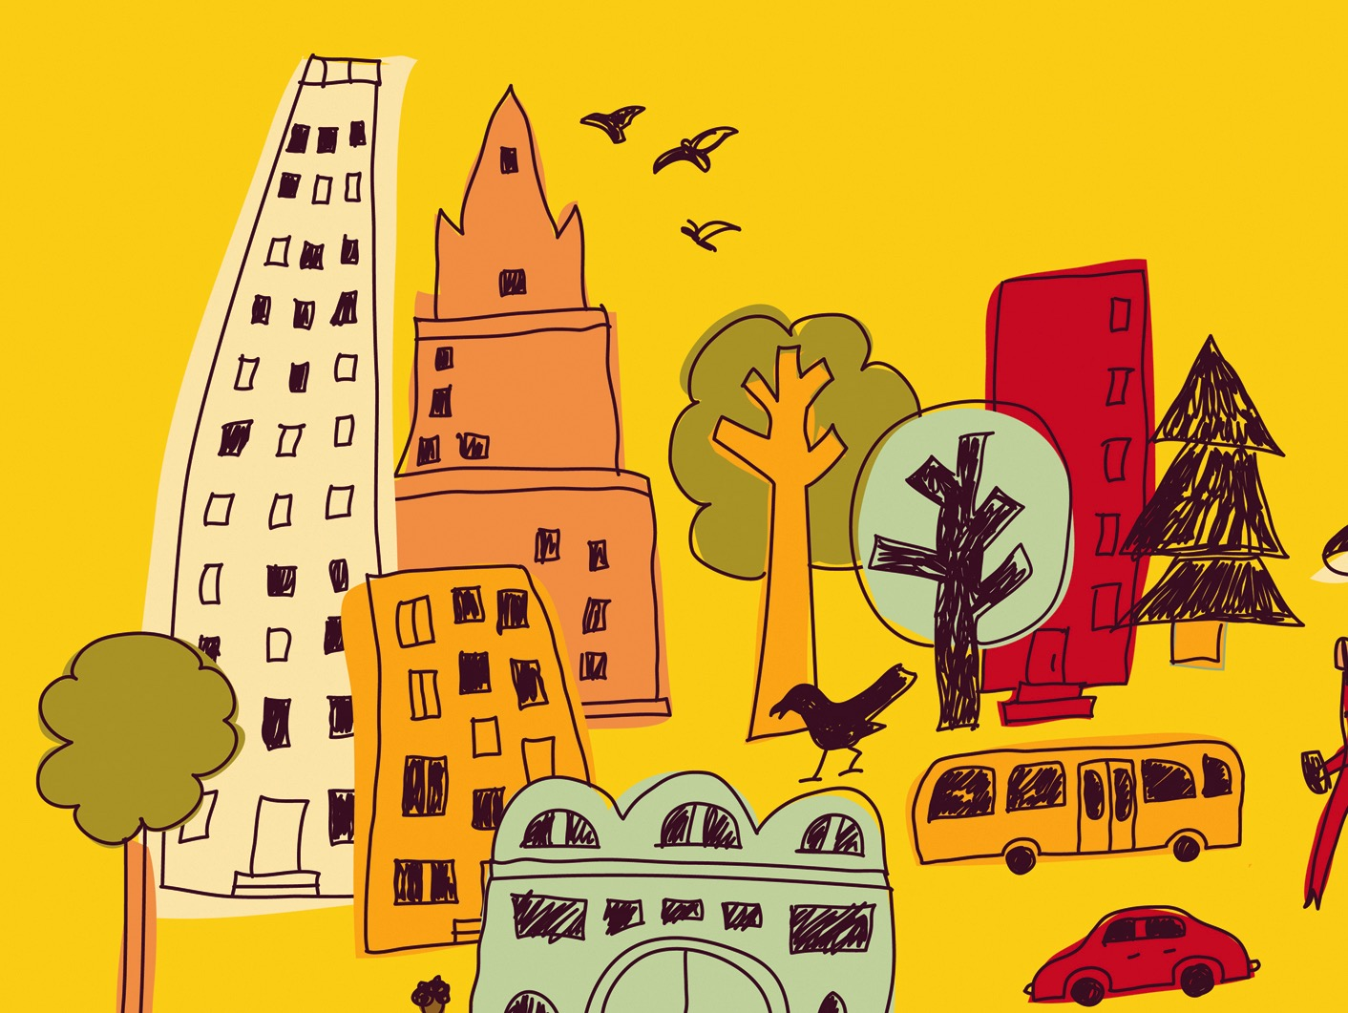
Learning Objectives
How anthropologists examine human interactions with the environment
Political ecology
Anthropocene
How anthropology contributes to public discussions and the creation of public policy

Slide 3
Living in the Anthropocene
The period in geological time in which the effects of human activities have altered the fundamental geochemical cycles of the earth as a result of converting forests into fields and pastures and burning oil, gas, and coal on a large scale

Slide 4
Humans and the Environment
Climate change led to bipedalism in hominins, development of Homo sapiens
Human agriculture changed our relationship with the environment in both positive and negative ways

Slide 5
Cultural Ecology
Leslie White – Cultures “evolved” through their use of technologies to control the environment
Julian Steward – (Shoshone) Subsistence patterns structure culture and society
Both were influenced by materialism – how human practices are limited by ecology and the balance of nature

Slide 6
Ethnoecology
The use and knowledge of plants, animals, and ecosystems by traditional societies
Horticultural practice of slash-and-burn or swidden cultivation
Practiced correctly, it is indefinitely sustainable with low population density and plenty of land
Incorrectly, the entire ecological system breaks down

Slide 7
Ethnoecology
Ethnobotany – studies traditional uses of plants for food, construction, dyes, crafts, and medicine
Kayapó Project showed how Indigenous groups actually make the rainforest more productive
Myth of the Ecologically Noble Savage
Native peoples are constructed as “opposite” of Western society, romantic fantasy
Land claims saved by mapping

Slide 8
Political Ecology
Focuses on the impacts of governments and corporations in establishing political and economic systems that constrain local behavior
Challenges standard narratives regarding environmental destruction and conservation
Revisionist Environmental History – uses evidence to rewrite narratives
Ex: Fairhead/Leach and Balee’s work

Slide 9
Political Ecology
“People versus Parks” Debate – Should rural lands be “protected” from the people who live there, or can there be a way to include humans and still conserve nature?
Sustainable development – economic alternatives that encourage people to preserve resources
Ex: Brazilian extractive reserves for rubber tapping
Ex: The American Lawn

Slide 10
Eco-Justice: Race, Gender, and Environmental Destruction
Environmental justice advocates look at social equality, identifying impacts and risks associated with environmental damage that have disproportionately affected socially marginalized groups
Landfills, chemical plants, industrial factories, environmentally-hazardous facilities
Eco-cide is linked to ethno-cide

Slide 11
Applying Anthropology in Conservation
Applied anthropologists work with conservation and development organizations to implement projects that depend on an accurate understanding of local cultures and practices to succeed
Ex: Murray’s Haitian reforestation project

Slide 12
Applying Anthropology in Conservation
AAA Global Climate Change Taskforce report (2014) – impacts of climate change will disproportionately affect groups who have contributed the least to greenhouse gases

