Slide 1
Perspectives: An Open Invitation to Cultural Anthropology, 2e
Performance

Slide 2
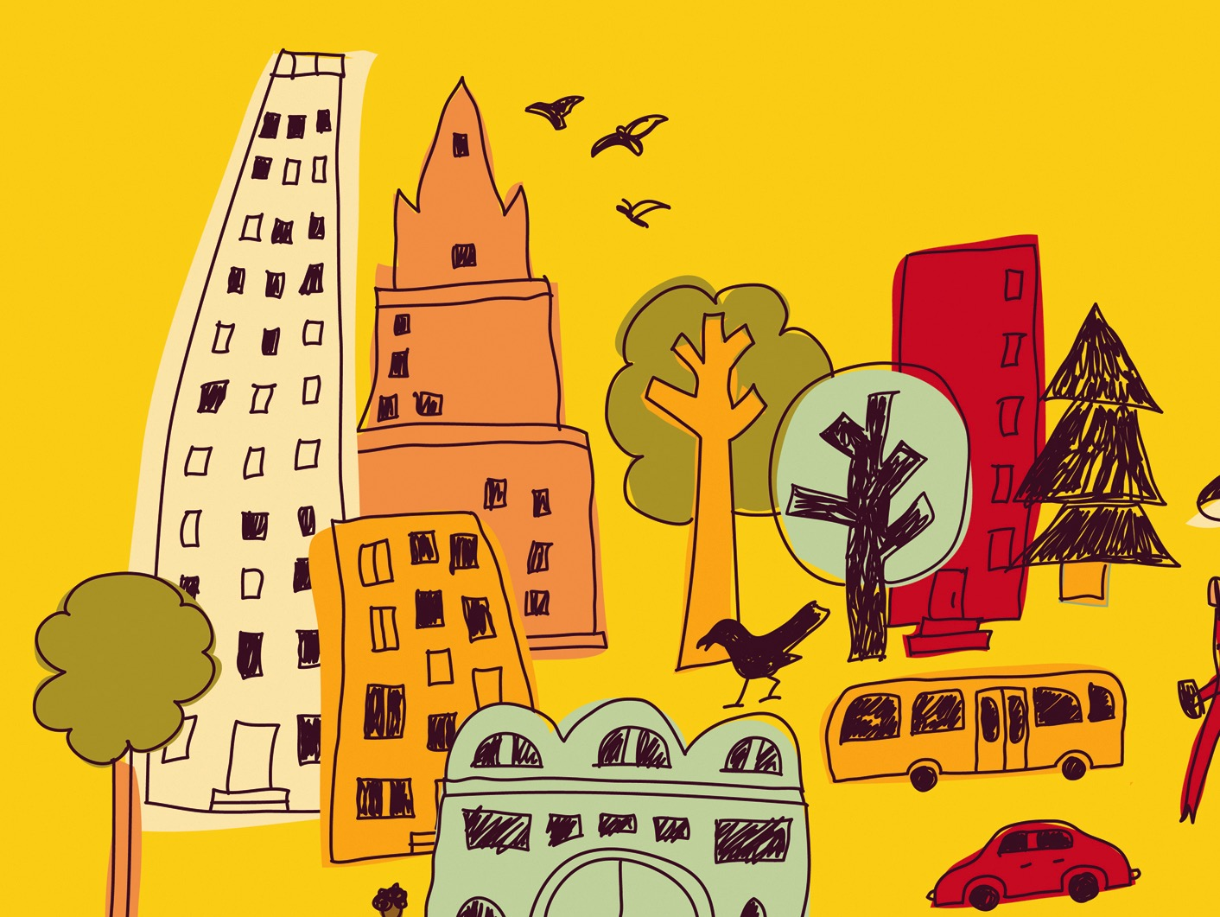
Learning Objectives
Cultural performances and performances of culture
Why anthropologists study performance
Performance and social change
“Presentation of self”
Performance and gender
Using a theatrical lens to analyze social conflict

Slide 3
Learning Objectives
Descriptive and performative utterances
Performance and hegemony (power)
Framing devices
Intertextuality

Slide 4
Cultural Performance vs. Performing Culture
Cultural performance is a performance
an authoritative version of culture
taking place at specific times and places
high level of excellence demonstrated by performers
Performing culture
the ways in which our everyday words and actions are reflections of enculturation, which may be studied as a performance

Slide 5
Presentation of Self
The ways in which people manage the impressions of others (Goffman)
Individuals act differently in different cultural contexts; not necessarily deceptive
“Front” and “back” spaces
A match between the “personal front” and setting (between expectation and execution) creates acceptance

Slide 6
Performance of Gender
Gender performativity (Judith Butler) –gender as a social construct is created through individual performances of gender identity
Patterns of behavior get culturally coded as gendered representations (“act like a man”)
Even movements of the body are culturally learned and performed

Slide 7
Social Drama as Performance
Conflict situations between individuals mirrors the action in a play (“metatheatre”)
Four phases
Breach
Crisis
Redress or Remedial procedures
Reintegration or Schism (fracture)

Slide 8
Performativity
Descriptive language – describes something (“The couple married.”)
Performative language – makes something happen (“I do.”)
Rituals are inherently performative – marks a social change
Political performativity can have serious consequences for social reality (supporting or resisting ideologies)

Slide 9
Bounded Performances
Rehearsals give performers embodied training and legitimacy; are culturally constructed
Framing devices – signify that what follows is a performance (“Once upon a time”)
Metacommunication – signals something about communication
Special codes, figurative language, parallelism, appeal to tradition, and others

Slide 10
Meaning Making
Three entities involved with constructing the meanings of bounded performances – author, artist(s), and audience (setting)

Slide 11
Meaning Making
Polysemy – settings, situations, or symbols where a single form can convey many meanings
artists can subvert author’s intentions, or audience may fail to understand
Performances may be entertainment or have political or social motivations

Slide 12
Recontextualized Performances
Intertexuality – the connections between original and subsequent versions of text and performance
Text – the source material, permanent artifact
Performance – interpretation of the text, unique, unrepeatable
The two may be explicitly linked for credibility, or inverted, creating an intertextual gap

Slide 13
Performance Communities
Performance is both informed by the norms of one’s community and signals one’s membership in the community
Space (studio, dojo) in which identity is formed; “folk geography” of art form
Globalization of performance forms raises questions of authenticity and cultural appropriation
Ex: Herbie Hancock and traditional Mbuti sounds

