Slide 1
Perspectives: An Open Invitation to Cultural Anthropology, 2e
Language

Slide 2
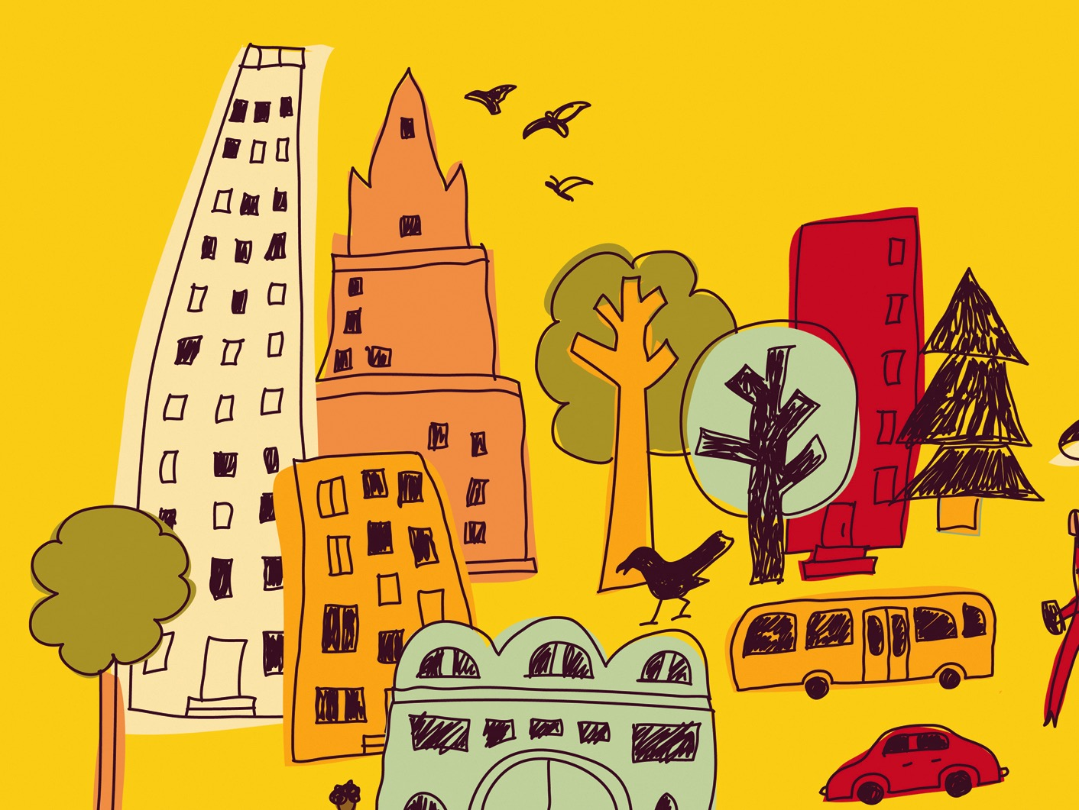
Learning Objectives
Human language and culture
Universal features of human language (including biology)
Unique features of human languages
The structures of language
Language and identity
Language change (historical linguistics) and preservation

Slide 3
The Importance of Human Language to Human Culture
Language can be considered a culture’s most important feature
Language and culture are inseparable
Relies on symbols
Arbitrariness

Slide 4
The Biological Basis of Language
Larynx (voice box or Adam’s apple) is lower in humans than in Great Apes
Pharynx (throat cavity) is longer
Tongue and palate (roof of mouth) are rounded
Brain structures for language are unique to humans

Slide 5
The Biological Basis of Language
Universal Grammar – innate ability for developing children to acquire language
Critical Age Range Hypothesis – child will gradually lose ability to acquire language naturally

Slide 6
The Biological Basis of Language
Open vs. Closed systems
Apes use Gesture-Call system
Non-verbal communication of humans includes:
Kinesics (body language)
Proxemics (use of space)
Paralanguage (background features of speech or sounds that convey meaning)

Slide 7
Human Language Compared with the Communication Systems of Other Species
Hockett’s Design Features – describe characteristics of all communication systems
Human language shares all characteristics and includes these features:
Discreteness
Duality of patterning
Displacement
Productivity/creativity

Slide 8
Descriptive Linguistics: Structures of Language
Phoneme – minimal unit of sound that makes a difference in meaning
Morpheme – minimal unit of meaning
Syntax – rules that govern how to put units of speech together
Semantics – meanings of words
Pragmatics – social and cultural context

Slide 9
Language Variation: Sociolinguistics
Language – standard variety of speech
Dialect – often used for subordinate variety of a language (result of colonization)
Many reasons for language variation
Registers – formality of speech
Code-switching – use of several varieties of language in a particular interaction

Slide 10
Language Variation: Sociolinguistics
Linguistic Relativity (the Whorf Hypothesis)
Whorf found no present, past, future tense in the Hopi lexicon
Language shapes the way we see the world
Metaphors guide our speech

Slide 11
Language in its Social Settings: Language and Identity
Social class
Ethnicity
Gender
Culture: Deaf culture

Slide 12
Language Change: Historical Linguistics and Globalization
Language taxonomies – classification systems, create a family tree of languages
Globalization, migration, and urbanization often leads to suppression of local languages
Language extinction/language death
Language shift

Slide 13
Language Change: Historical Linguistics and Globalization
Language Revitalization
Use of Internet in language survival
Advanced technology and digital age are also creating a communication gap
Social status
Generation gap
Political activism

