Slide 1
Perspectives: An Open Invitation to Cultural Anthropology, 2e
Subsistence

Slide 2
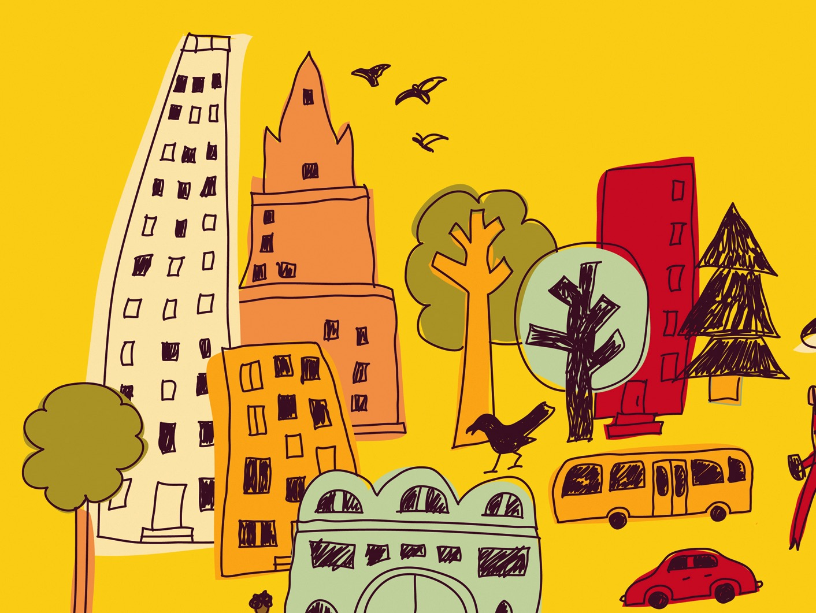
Learning Objectives
Four modes of subsistence
Domestication of resources
How subsistence and wealth are connected
Subsistence systems and gender roles
Agriculture
How global agricultural system contributes to wealth differences
Human intervention in the “natural” environment

Slide 3
Studying Subsistence Systems
Subsistence systems – the set of practices used by members of a society to acquire food
Foodways – the cultural norms and attitudes surrounding food and eating
Food is essential for humans, dependent on the carrying capacity of the land
Every person plays a role as a producer, distributor, or consumer of food

Slide 4
Modes of Subsistence
Every household must feed its members, creating a domestic economy that interacts with modes of production and exchange
Immediate return system vs. Delayed return system
Four modes of subsistence:
Foraging, Pastoralism, Horticulture, Agriculture

Slide 5
Foraging
Relies on wild plant and animal food resources already available in the environment
Hunting, fishing, gathering of wild plant resources – broad spectrum diet
Only immediate return system
Small groups, with low population densities

Slide 6
Foraging
Egalitarian social structure
Generosity and sharing are social norms and a survival strategy
Work is divided among gender lines
Mostly nomadic groups, although a few sedentary foraging societies have existed

Slide 7
Foraging
Marshall Sahlins: “the original affluent society”
However, foraging is challenging and leisure time varies by group
Not isolated, but in competition for resources with non-foraging groups
Even foragers have manipulated the environment

Slide 8
Pastoralism
Relies on herds of domesticated livestock
Nomadic pastoralism moves herds to available grazing fields and water several times a year
Animals are kept alive and fed well to produce dairy products, wool, dung
Trade with neighboring farms for other products

Slide 9
Pastoralism
Social life and status revolve around animal herds
Men own cattle, women (and children) tend cattle
Personal property is owned
Act to conserve their environments using land restrictions and regulations
Modern pressures threaten this lifestyle

Slide 10
Horticulture
Relies on small gardens that move periodically
Simple tools and physical labor
Crops consumed by family units or exchanged with others in the community
Also supplement their diets by raising animals for protein

Slide 11
Horticulture
Use shifting cultivation (“slash and burn”)
Multi-cropping and intercropping
Social life revolves around growing crops, which are used as gifts and signs of social status, also imbued with spirits

Slide 12
Agriculture
Cultivation of domesticated plants and animals using technologies such as irrigation, draft animals, mechanization, and chemical inputs
Allows for intensive and continuous use of land resources – led to Neolithic Revolution
Reliance on few staple crops, often starches

Slide 13
Agriculture
Population growth likely need to the need to create larger and more productive farms
Farms also require more labor, encouraging farmers to have more children as laborers
Division of labor and specialization occur, leading to wealth differences
Can be argued that it led to a lower quality of life

Slide 14
The Global Agriculture System
Enough food production exists to feed all the people on the planet, but unequally distributed
Today, food exists in a world system
Each product has a commodity chain, moving items far from their point of origin
Distance and competition replace communal experiences

