Slide 1
Perspectives: An Open Invitation to Cultural Anthropology, 2e
Economics

Slide 2
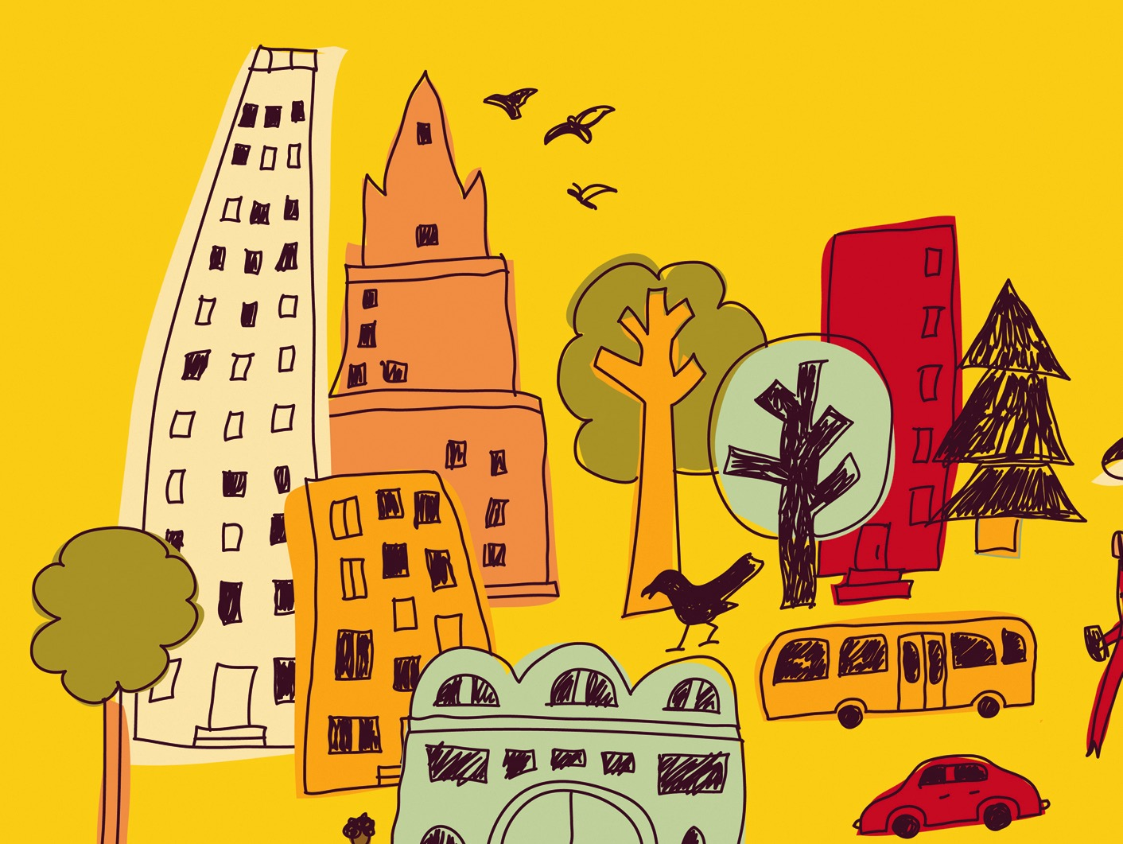
Learning Objectives
Economic anthropology
Three modes of production
Three modes of exchange
General purpose money
Commodities
Global economic inequality

Slide 3
Economic Anthropology
How humans work to obtain the material necessities such as food, clothing, and shelter
How people produce, exchange, and consume material objects
The role that immaterial things such as labor, services, and knowledge play in our livelihood
Economic anthropologists describe what people actually do and why

Slide 4
Modes of Production
Domestic Production (kin-ordered)
Foragers and small-scale farmers
Egalitarian
Labor organized by kinship relations
Collective ownership of means of production
Lower rates of social domination
Sharing

Slide 5
Modes of Production
Tributary Production
Societies with classes of rulers and subjects
Farmers and herders who produce for themselves but also give portion to rulers as tribute
Communities organized by kinship
Tribute is used by ruling class rather than exchanged
Relationships often conflictual
Production is controlled politically

Slide 6
Modes of Production
Capitalist Production
Began during 17th and 18th Centuries
Private property owned by a capitalist class
Workers sell their labor to others, are separated from the means of production
Keep wages low in order to sell products for more than it costs to produce the products
Generates a surplus

Slide 7
Modes of Production: Examples
Fair-Trade Coffee Farmers: 21st Century Peasants
Small-scale, semi-subsistence farmers in highland Guatemala (Maya)
Salaula in Zambia: The Informal Economy
Global clothing recycling business

Slide 8
Modes of Exchange
Reciprocity – Giving gifts create relationships
Generalized – Exact value of the gift and time is not specified (Halloween)
Balanced – Something of equal value and time period is expected (Kula ring)
Negative – attempt to get something for nothing
Ex: Christmas giving

Slide 9
Modes of Exchange
Redistribution – the accumulation of goods or labor by a particular person or institution for the purpose of dispersal at a later rate
Requires a centralized political body to coordinate and enforce
Found in all societies
Ex: potlatch

Slide 10
Modes of Exchange
Markets – social institutions with prices or exchange equivalencies
Regulated by supply and demand
Based on transactions, often impersonal but not always
Ex: Maine lobster markets

Slide 11
Modes of Exchange
Money – General purpose money
medium of exchange
tool for storing wealth
way to assign interchangeable values
Increases opportunities for unequal exchange
Ex: Tiv spheres of exchange
Ex: Ithaca HOURS

Slide 12
Consumption and Global Capitalism
Consumption – the process of buying, eating, or using a resource, food, commodity or service
Forms of behavior that connect our economic activity with the cultural symbols that give our lives meaning
Commodity – a good that is produced for sale or exchange for other goods
Objects have a “social life”

Slide 13
Consumption and Global Capitalism
In the developing world, worries that Westernization around the world would change values has been challenged
Global supply chains move commodities around the world
Ex: Darjeeling Tea production and consumers

Slide 14
Political Economy: Understanding Inequality
Political economy – contextualizes economic relations within state structures, political processes, social structures, and cultural values
Structural violence – a social structure or institution harms people by preventing them from meeting their basic needs
Ex: the politics of aid to Haiti

Slide 15
Conclusion
Multiple forms of economic production and exchange structure our daily lives
Community economies framework may decrease economic inequities by recognizing our interdependence
Central goal of economic anthropology is to support equality

