Slide 1
Perspectives: An Open Invitation to Cultural Anthropology, 2e
Political Anthropology: A Cross Cultural Comparison

Slide 2
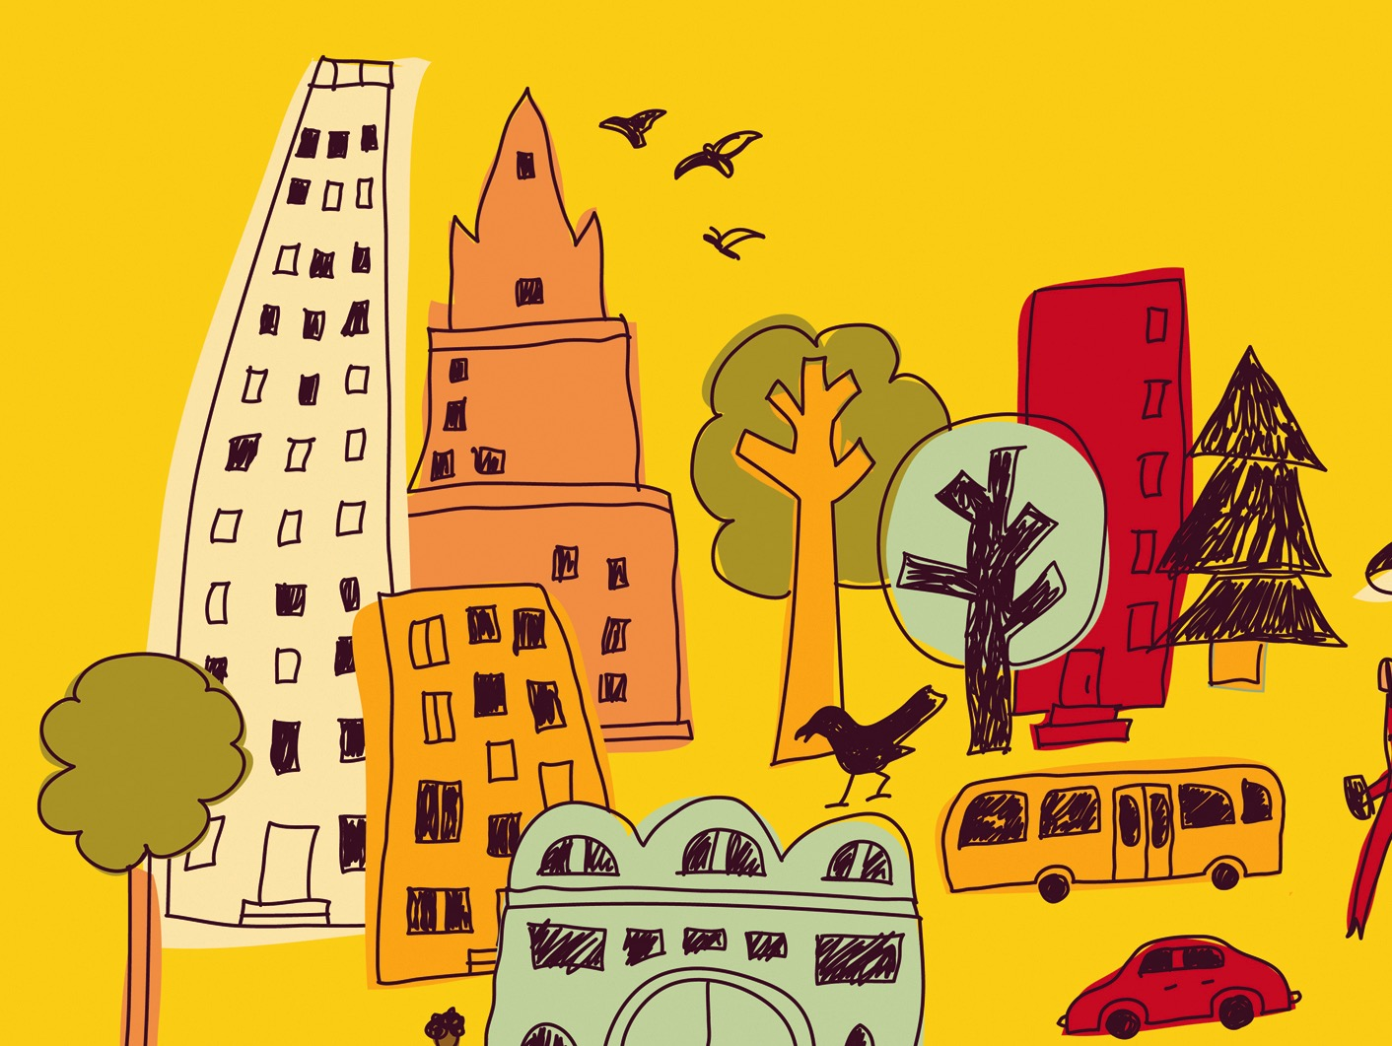
Learning Objectives
Four levels of socio-cultural integration
Leadership in egalitarian and non-egalitarian societies
Tribes and chiefdoms
States
How the Islamic State meets the requirements of a state-level political organization

Slide 3
Basic Concepts in Political Anthropology
How societies exercise political control
Power – the ability to induce behavior of others in specified ways by means of coercion or physical force
Authority – the ability to induce behavior of others by persuasion
Legitimacy – the perception that an individual has a valid right to leadership

Slide 4
Levels of Socio-Cultural Integration
Elman Service (1975) – Four Levels
Band
Tribe
Chiefdom
State
Egalitarian, Ranked, and Stratified societies

Slide 5
Egalitarian Societies: Bands
Few differences between members in wealth, status, and power
Bands
Foragers
Nomadic
Lack formal leadership or adjudication
Modesty is valued
Interpersonal arguments create conflict

Slide 6
Egalitarian Societies: Tribes
Tribes
Defined groups linked together
100 – 5,000 people
No centralized government
Leadership roles open, not hereditary
Social integration through sodalities, men’s houses, formal gift exchanges, and marriage

Slide 7
Law in Tribal Societies
Use negotiation, mediation, or divine events to resolve conflict
Warfare consists of raids or feuds both internally and externally

Slide 8
Ranked Societies: Chiefdoms
Greater differentiation between individuals and their kin groups, hierarchy of prestige
Chiefdoms
Permanent political office of chief, may be hereditary
Economic redistribution
Social integration through marriage and secret societies

Slide 9
Stratified Societies
Elites (a numerical minority) control strategic resources that sustain life
Ex: Caste systems
membership is determined by birth, no movement from one to another (such as in class systems); endogamous marriage

Slide 10
Stratified Societies: State
State
Political power is centralized in a government that has a monopoly over the legitimate use of force
Large, diverse populations
Complex economies (often market economy)
Social stratification
Intensive agriculture or industrial subsistence
Defined geographical territory

Slide 11
Stratified Societies: State
Heads of state, often with councilors
Administrative bureaucracy handles public functions
Taxation or tribute
Ideologies maintain the elites’ power
Nation is not synonymous with state
Nation is a group connected by language, territorial base, history, political organization

Slide 12
Stratified Societies: State
How do states form?
Elite minority controls resources of majority
Increased agricultural productivity
Peasant farmers were the original subjects of state society formation, i.e. state controls peasant resources
Loss of land and self-sufficiency

Slide 13
Stratified Societies: State
Law is formal and codified, adjudication
Warfare is widespread
led to acquisition of resources by taking control of adjacent populations
Tendency toward instability
Extreme disparities in wealth, use of force, stripping of peoples’ resources, harshness of laws

Slide 14
The Islamic State: A State in Formation?
ISIS formed in 2014 in Iraq and Syria, a military organization based on theocratic ideals
Has features of a state society
Armed force
Resources and revenue
Administrative structure
A body of law
Uses the Internet to spread ideology

